Slide 1
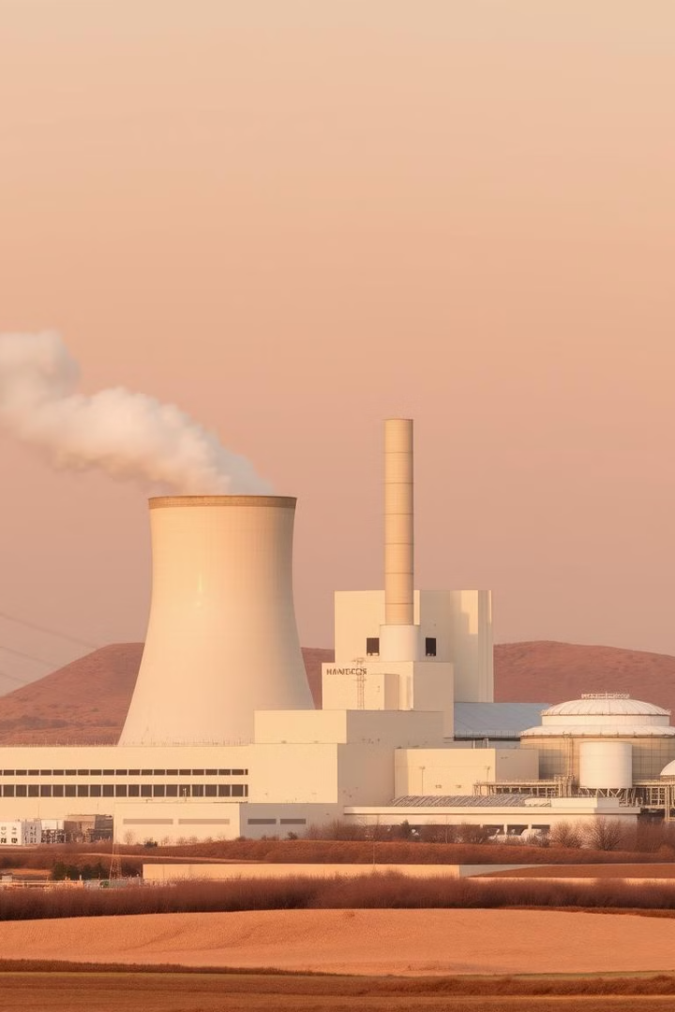
Energy Production Prediction for Combined-Cycle Power Plant
Optimize energy output using machine learning. This project predicts megawatt production based on environmental factors. Efficient energy generation impacts costs and operational effectiveness in combined-cycle power plants.

Slide 2

Project Overview
1
Objective
Predict energy output based on environmental factors. Optimize plant performance and support sustainability goals.
2
Problem Statement
Identify how temperature, exhaust vacuum, pressure, and humidity influence energy production.
3
Timeline
Complete project within 30 days, ensuring thorough analysis and reliable model development.

Slide 3

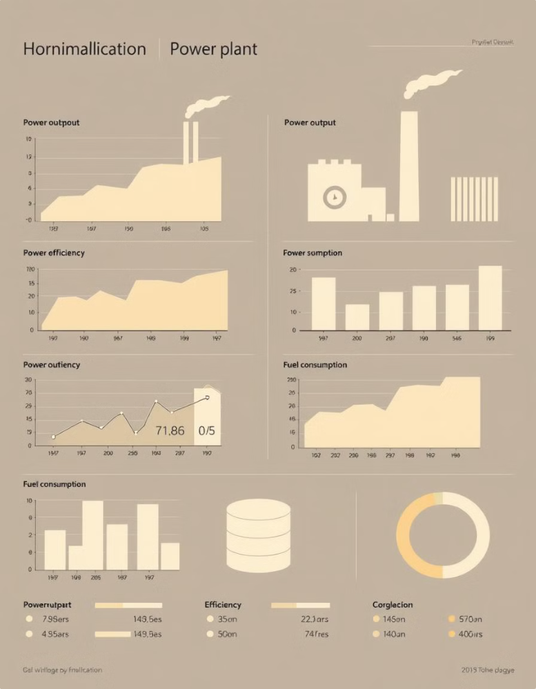
Dataset Description
Observations
9,568 records
Features
Temperature (°C), Exhaust Vacuum (cm Hg), Ambient Pressure (mbar), Relative Humidity (%)
Target Variable
Energy Production (MW)
Collection Period
Six years, full load operation

Slide 4
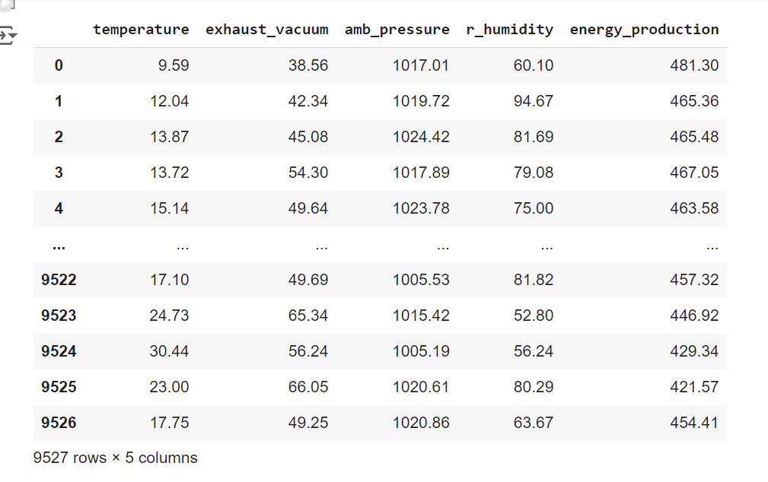
Data set

Slide 5

Exploratory Data Analysis (EDA)
1
Univariate Analysis
Examine feature distributions using histograms, box plots, and summary statistics.
2
Bivariate Analysis
Explore correlations between features and energy production through scatter plots.
3
Correlation Matrix
Visualize relationships between variables, highlighting strongest predictors of energy output.

Slide 6
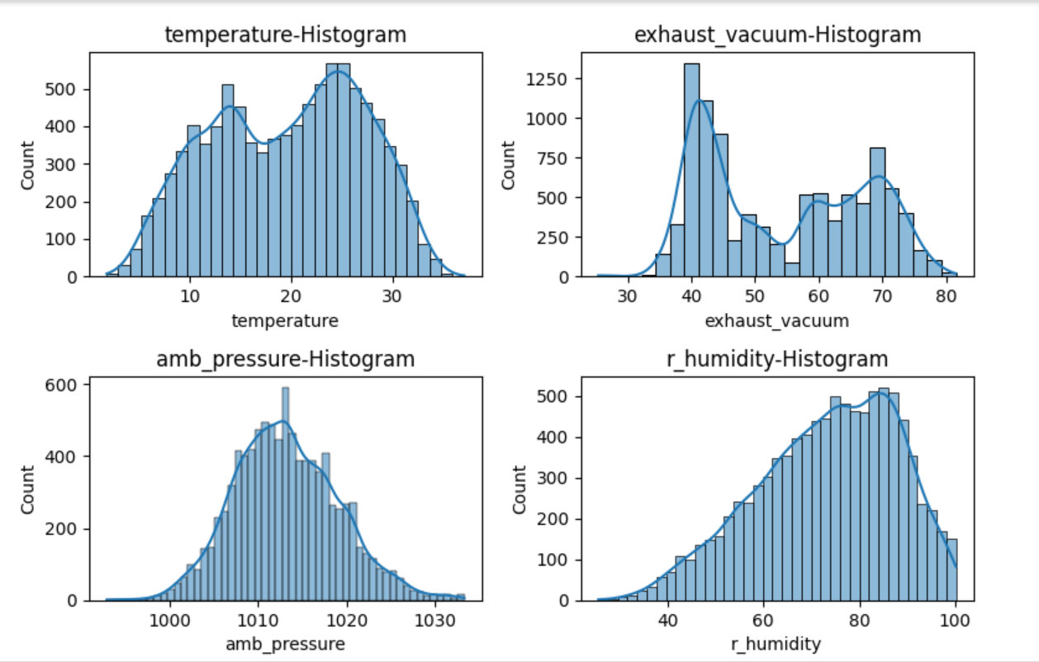
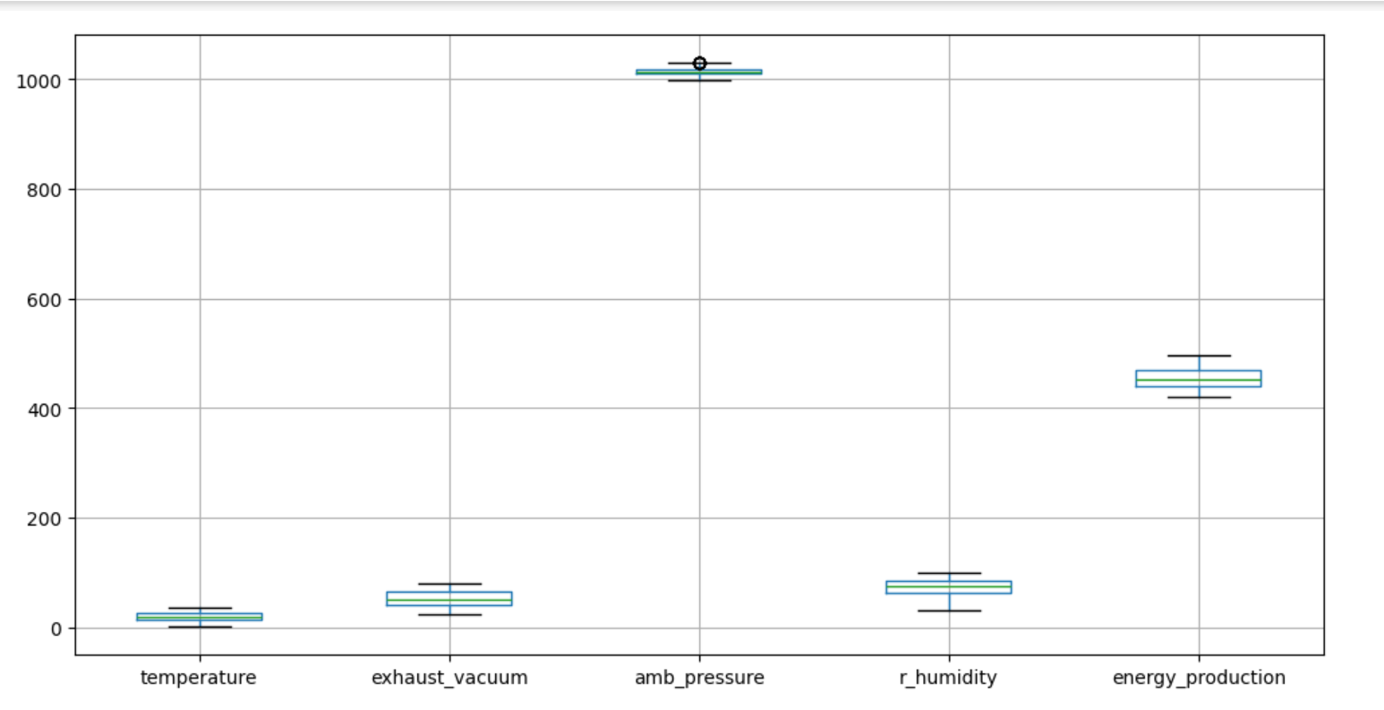
Histograms
Box plot

Slide 7
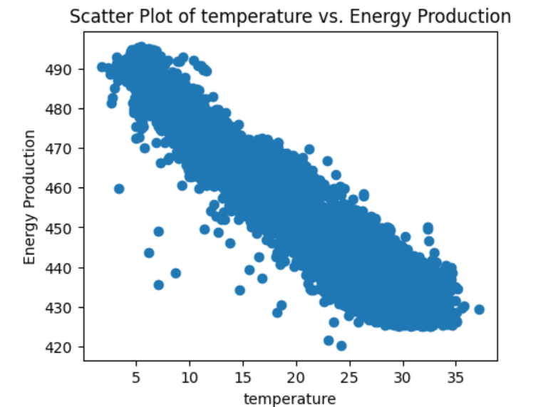
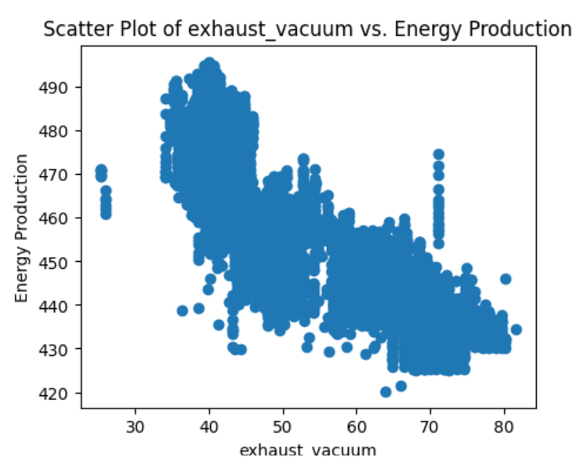
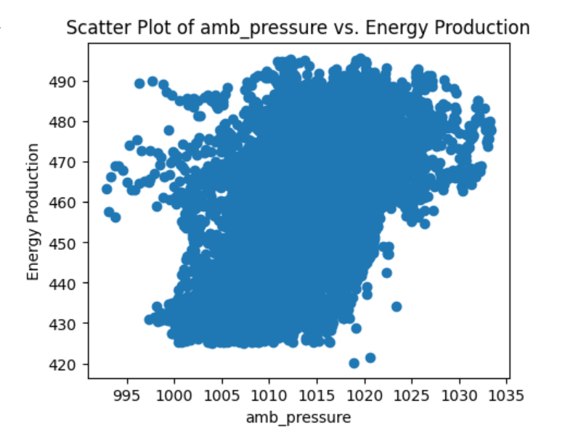
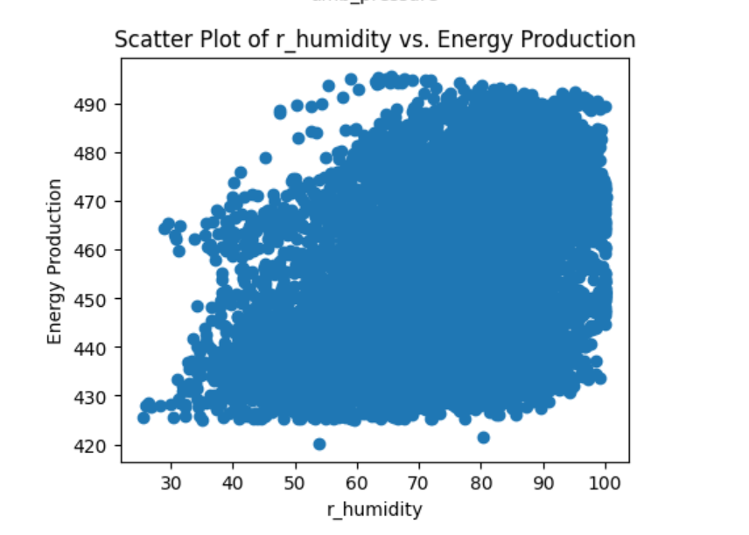

Slide 8
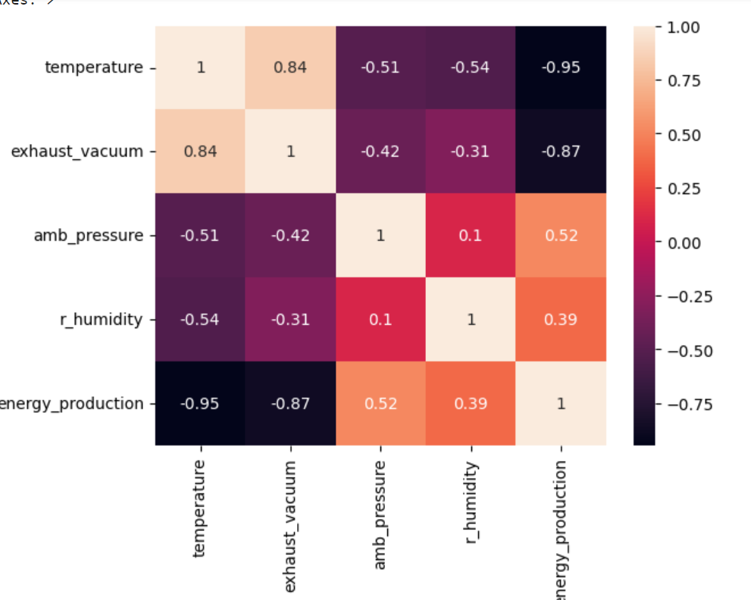
Correlation Matrix

Slide 9

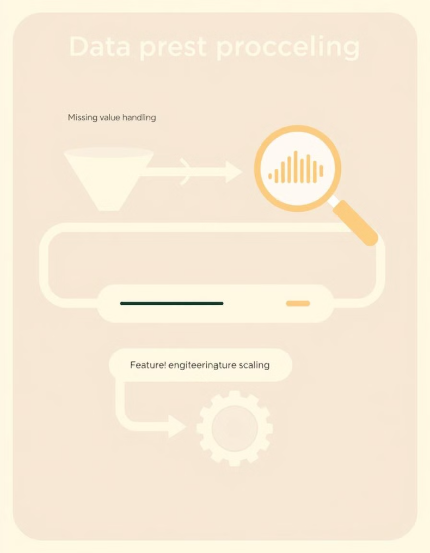




Data Preprocessing
Missing Values
Check for null values to ensure data integrity and accuracy.
Outlier Detection
Identify extreme values using box plots and statistical
methods.
Feature Scaling
Normalize data to bring all variables to a similar scale.
Feature Engineering
Create or transform features if needed to enhance model performance.

Slide 10
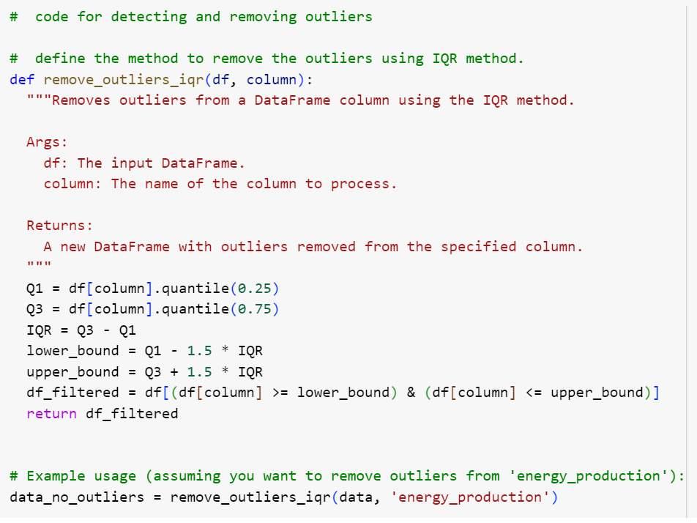

Slide 11
Model Building
Linear Regression
Random Forest Regressor
Gradient Boosting Regressor
Baseline model with interpretable coefficients. Captures linear relationships between features and target.
Ensemble method capturing non-linear relationships. Reduces overfitting through multiple decision trees.
Advanced technique combining weak learners. Often achieves highest accuracy in regression tasks.

Slide 12
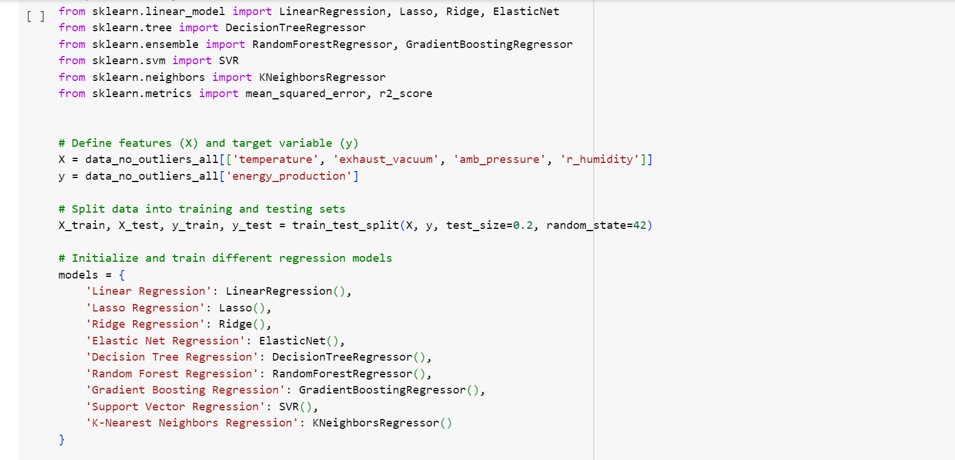
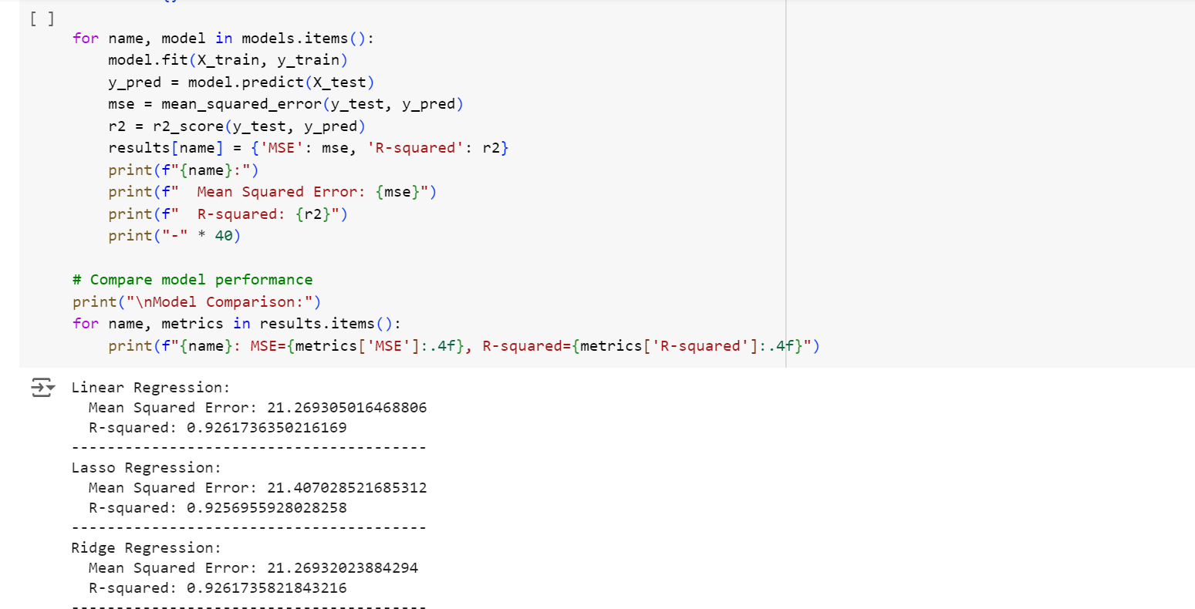

Slide 13
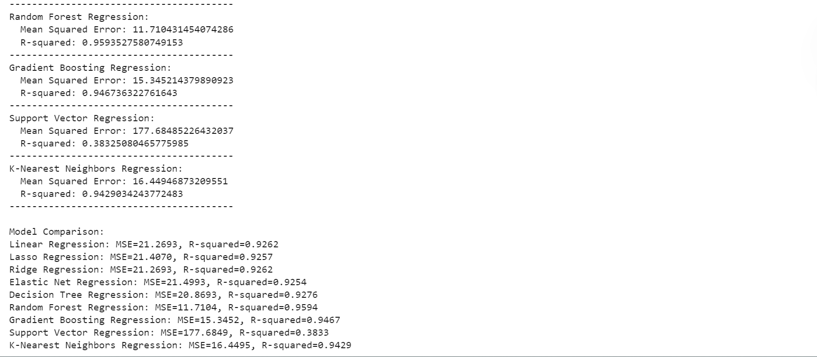

Slide 14

Model Evaluation
Model
MAE
MSE
R-squared
Linear Regression
3.6441
20.8782
0.9283
Random Forest
2.3281
11.0429
0.9621
Decision
2.9628
19.7365
0.9322
Tree

Slide 15


Model Deployment
1
Web App Development
Create user-friendly interface using Streamlit for real-time predictions.
2
Input Processing
Design form for users to enter environmental conditions and operational parameters.
3
Backend Integration
Connect input data to deployed model for instant energy output predictions.
4
Output Display
Present predicted energy production clearly, enabling informed operational decisions.

Slide 16
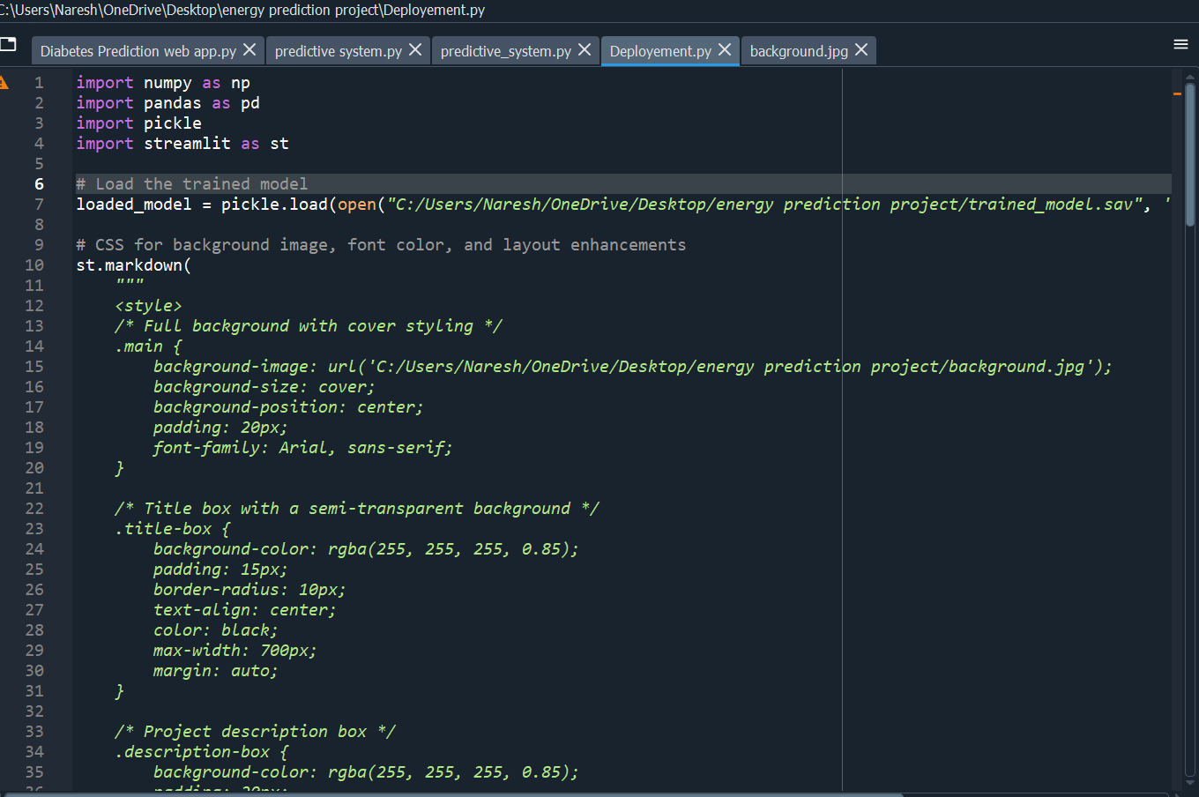
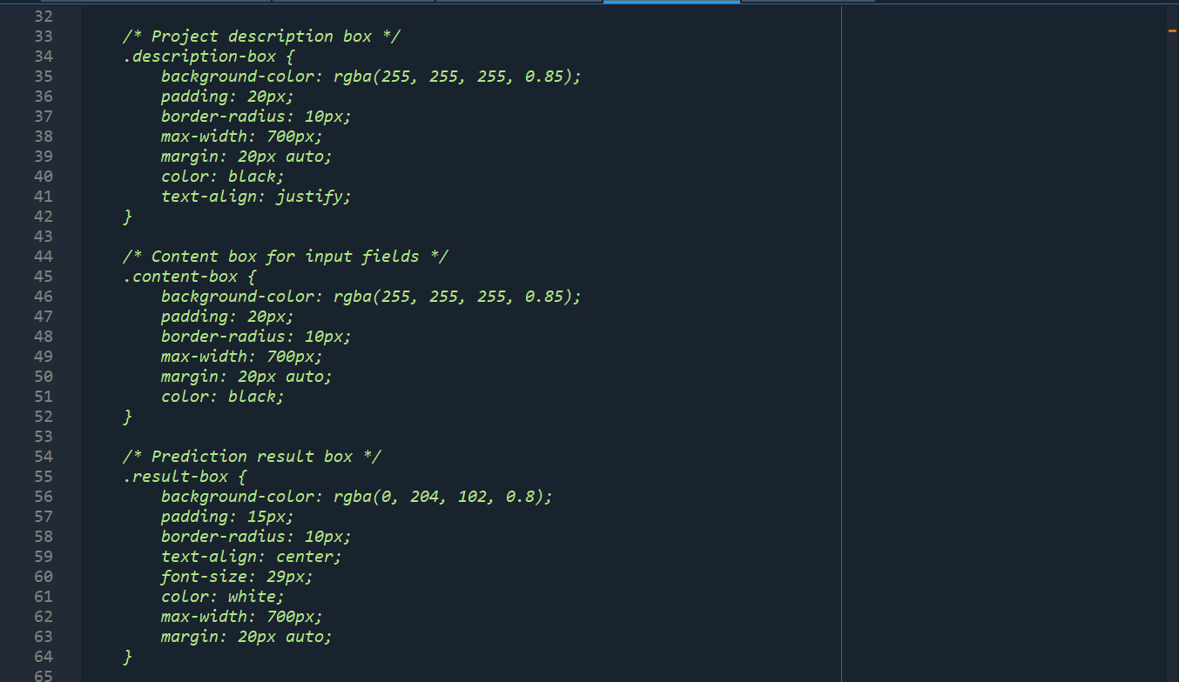
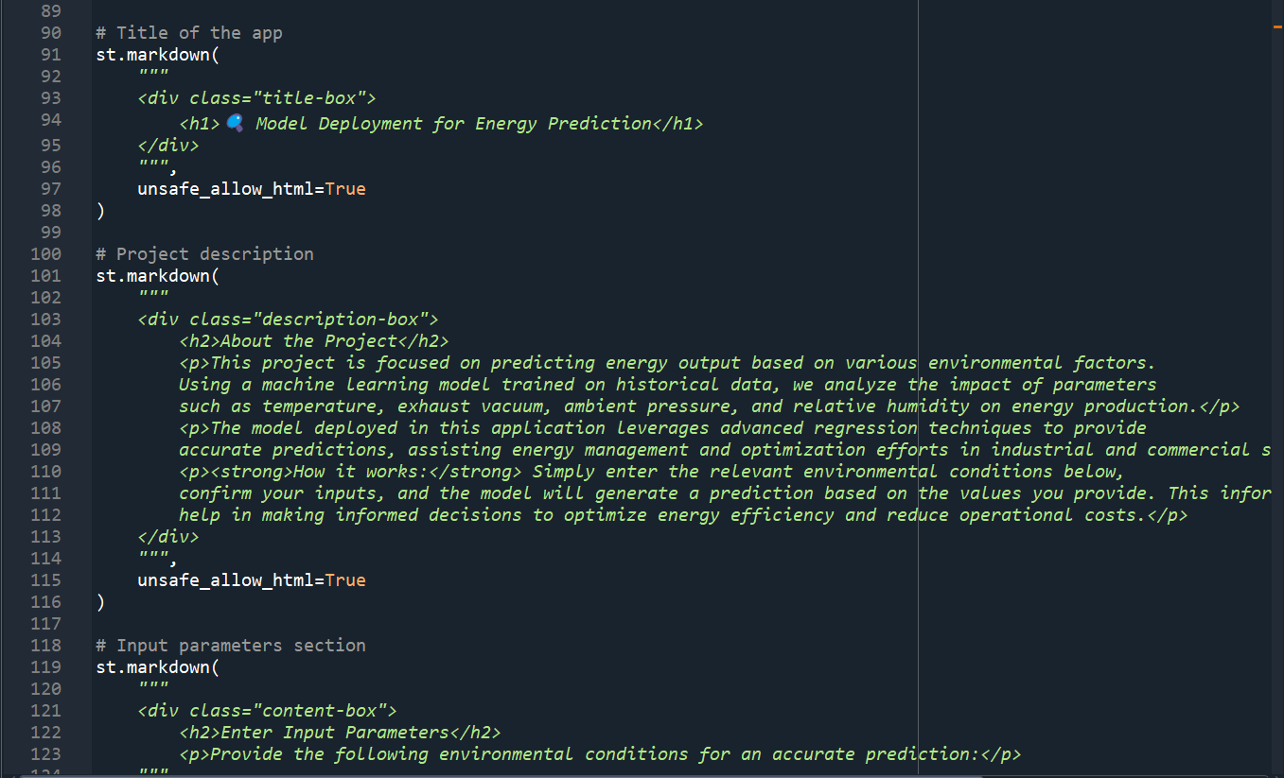
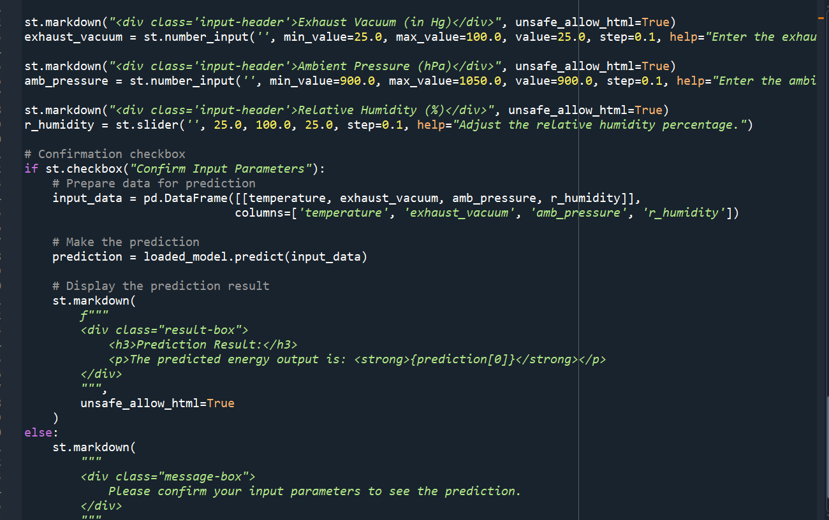

Slide 17
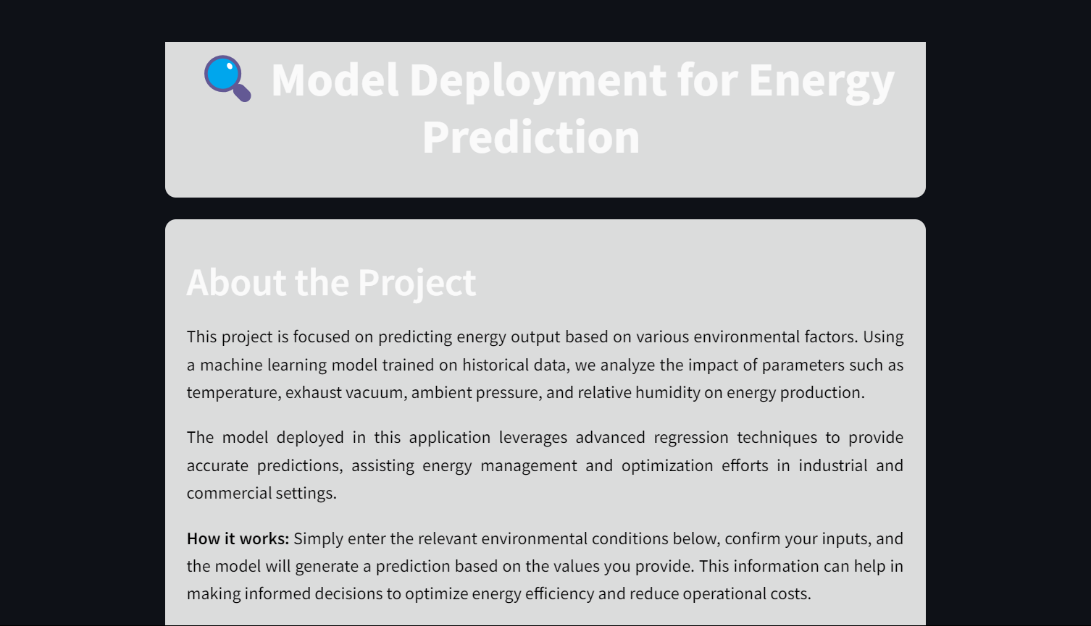
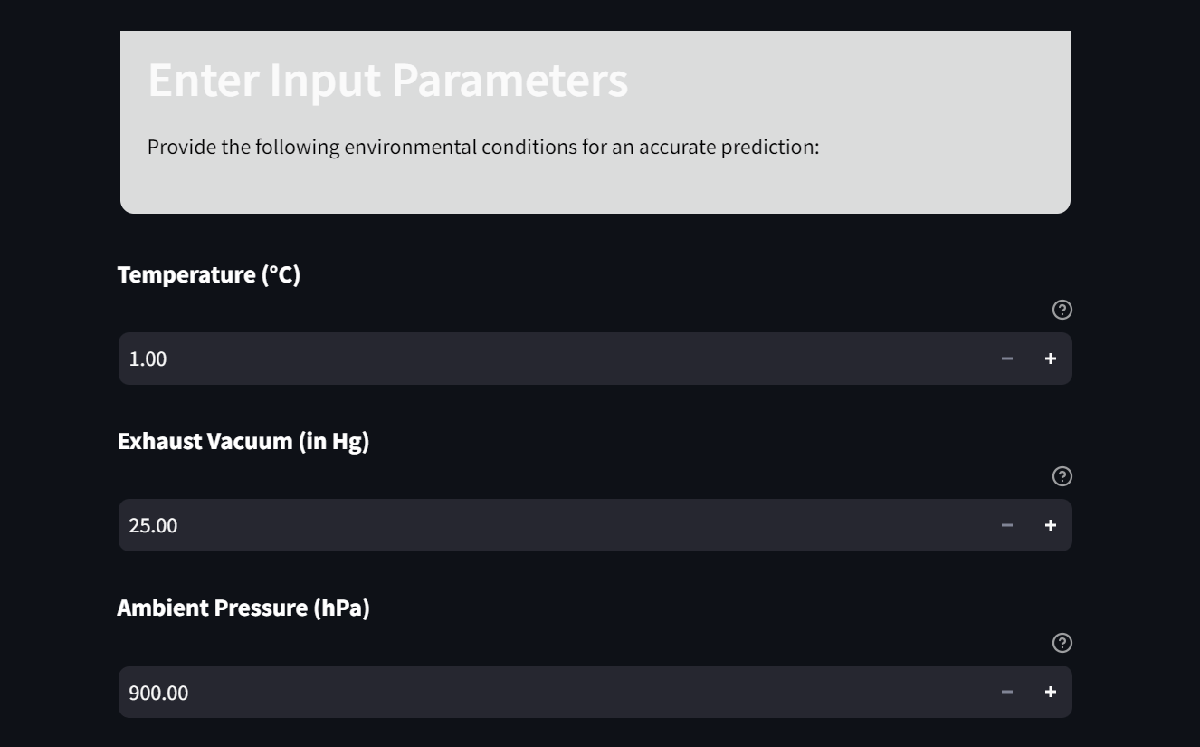


Slide 18
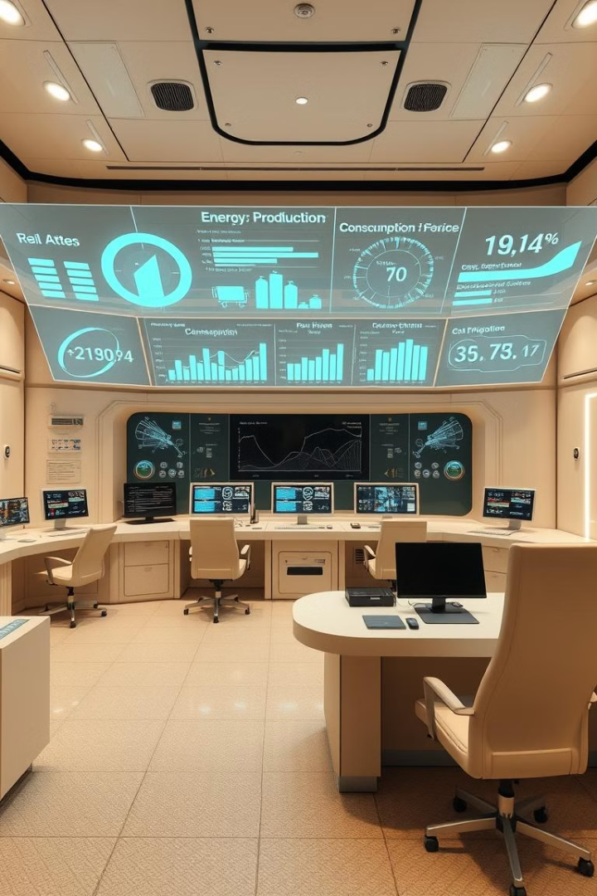
Final Insights and Recommendations
Key Takeaways
High model accuracy enables optimized plant efficiency. Temperature and exhaust vacuum are primary production influencers.
Business Impact
Real-time predictions guide operational adjustments, reducing inefficiencies and improving energy output.
Future Work
Integrate real-time data sources, incorporate additional variables, and implement regular model updates.

Slide 19

Thank You

